Slide 1
William Echikson
Director, Brussels Office
European Union of Progressive Judaism

Slide 2
Why the EU And Holocaust Revisionism?
The European Union was born out of the ashes of World War II to protect minorities and ensure “never again.”
Countries joining up to the EU made great progress coming to terms with their guilt – led by Germany.
Central European countries applying for EU membership made progress in coming to terms with their past

Slide 3
How Did We do the Study?
TWO AMERICAN UNIVERSITIES
+
European Institution

Slide 4
Revisionism Rising
Newly Freed Countries are rehabilitating war criminals and minimizing their own guilt.
POLAND HUNGARY CROATIA BALTICS

Slide 5
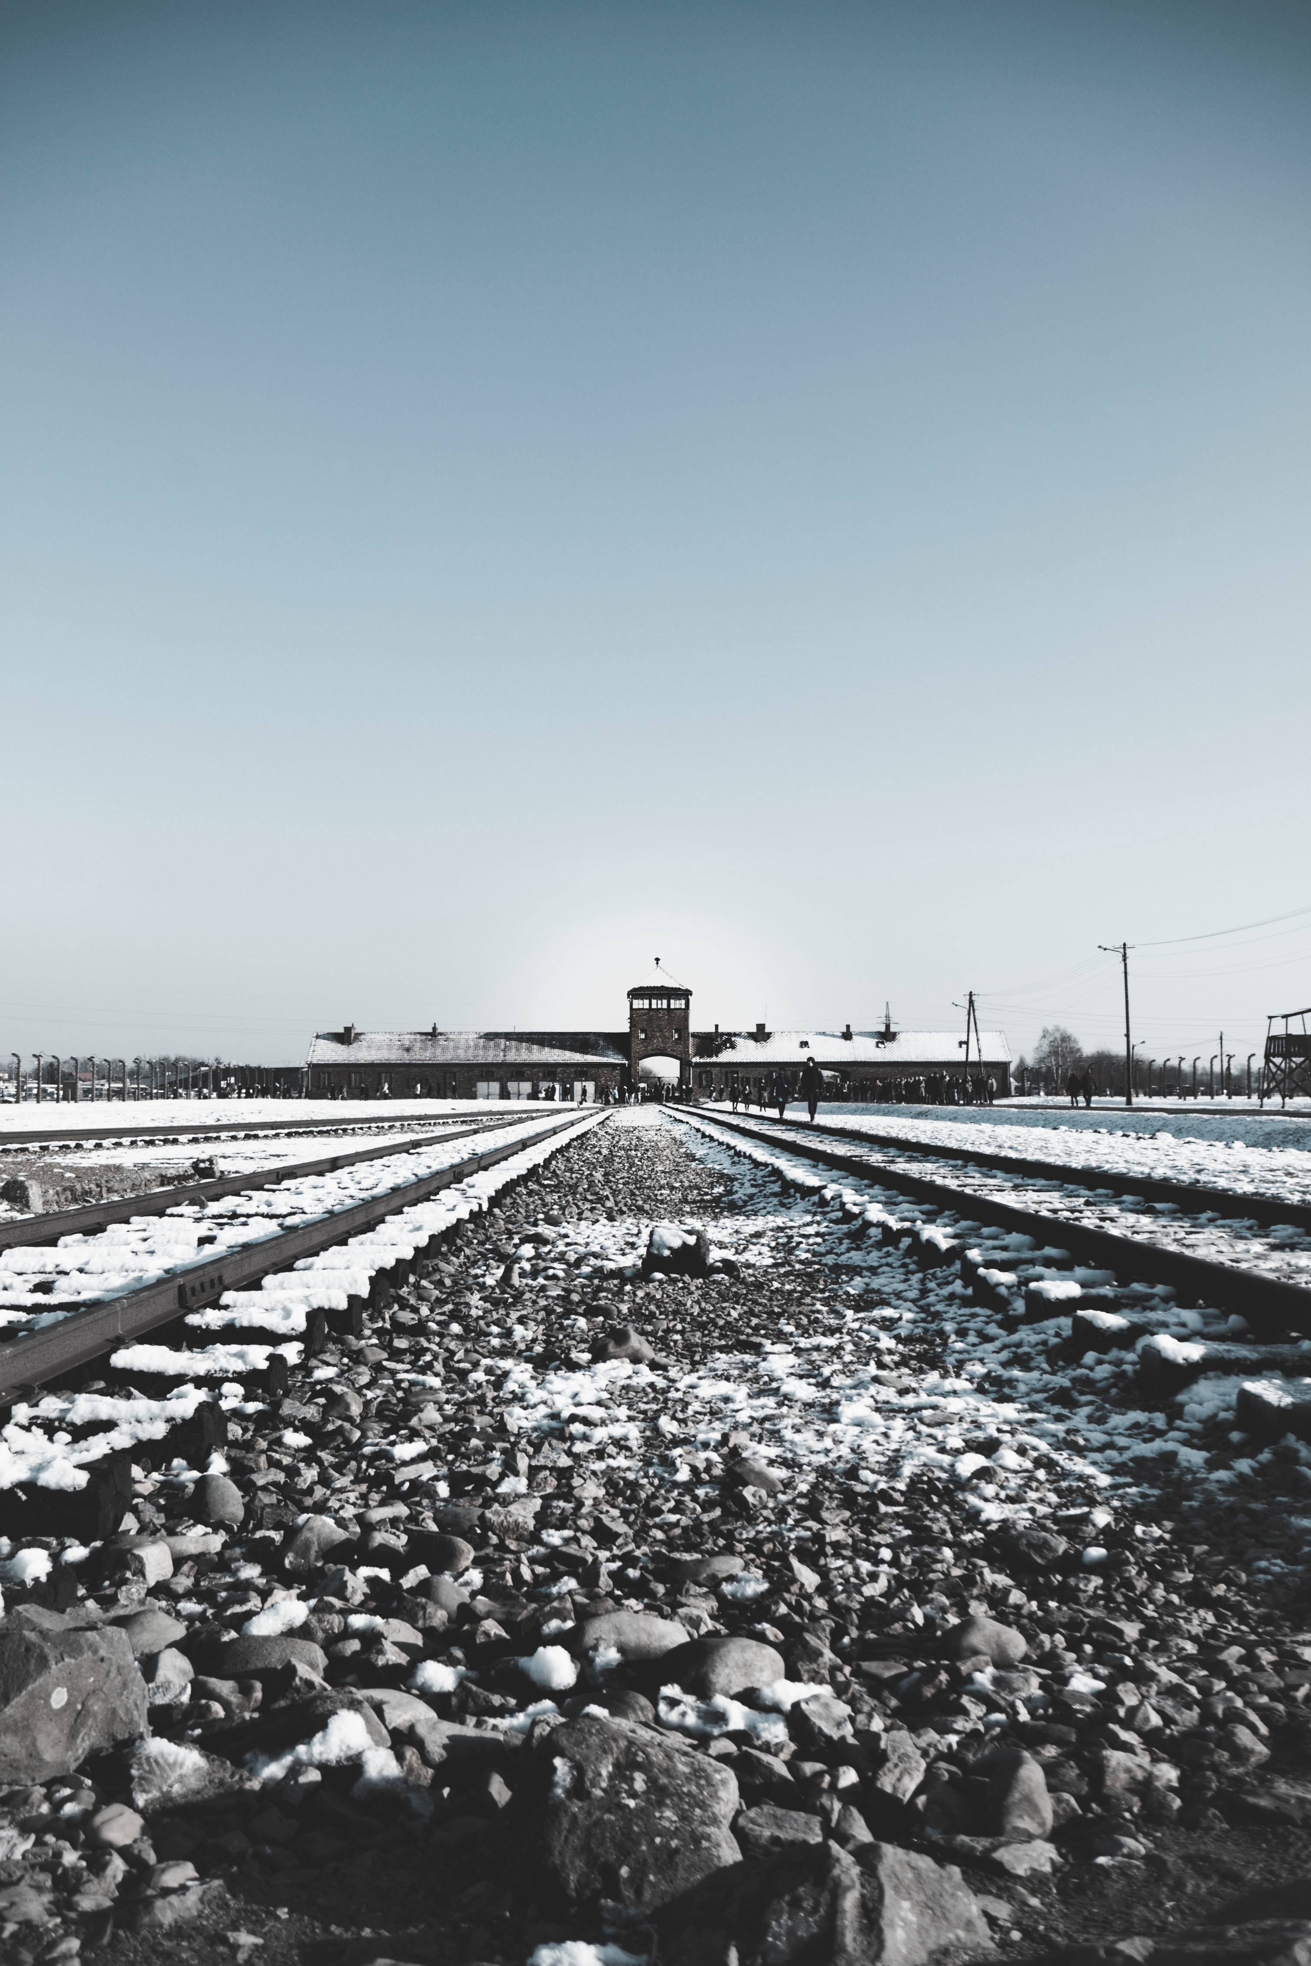
BLOODLANDS
Eastern Europe Suffered the More than Western Europe

Slide 6
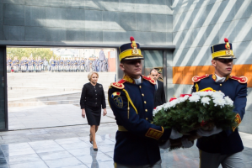
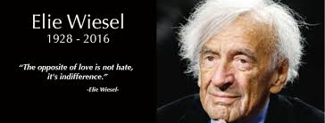
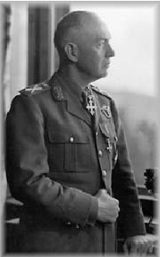
Romania Represents a Big, Positive Exception
Creates Independent 2003 Wiesel Commission
Acknowledges Antonescu’s Crimes
Revamps Educational System
General Staff Receive Responsibility Trainings

Slide 7
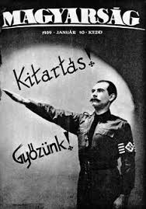
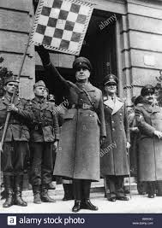
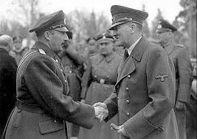
Challenged Countries Need to Create Independent International Commission on the Romanian Model
Croatia – Proposal Raised Several Times, only to be rejected
Bulgaria – Independent Assessment of King’s Role
Hungary – Assess Horthy and Iron Cross
Poland – Study Polish Resistance and Local Anti-Semitism.
Lithuania – The line between Communist resistance and Nazi Collaboration

Slide 8
Surprising Successes in the West
AUSTRIA
Leader in art restitution
Despite far-right in coalition, strong statements in Israel
Used EU Austrian Presidency to make advances fighting anti-Semitism

Slide 9
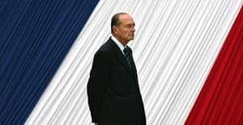
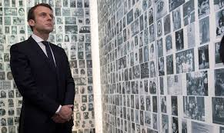
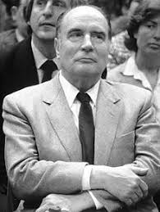
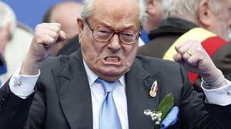
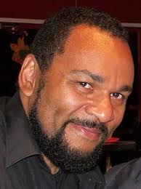
FRENCH REVOLUTION
From Vichy to Macron

Slide 10
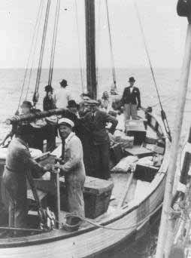
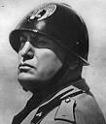
Challenges in the West, Too
DENMARK
ITALY

Slide 11
European Union Fights Revisionism
Appoints first Coordinator to Fight Anti-Semitism
FRA Conducts Pathbreaking Poll and Research
Joins International Holocaust Remembrance Alliance
Ups Spending to Fight Anti-Semitism

Slide 12
Israel’s Dubious Role

Slide 13
BRUSSELS OFFICE NEXT STEPS
Rabbinical Assistance: We need to name a replacement to Rabbi Ira as the rabbinical lead for the EUPJ office
State Recognition Mapping: A volunteer named Andris Mosquera said he wanted to follow up with the mapping of our efforts to gain state recognition throughout the continent. This is important to help communities learn “best practices,” for us to understand the stakes (financial, political and religious) in each country, and finally for the Brussels office to be able to explain the situation in individual countries to EU officials. A proposed template is attached. Please feel free to propose improvements? Would it be possible to send it out to all community leaders and for them to engage with Andres to put together this mapping?
Bulgaria: One of the nice fallouts from our Brussels office opening was an email from my Yale classmate, now American ambassador to Bulgaria, Eric Rubin. He is an active progressive Jew and has been active in Bulgarian Jewish affairs and he advises us to work to set up a progressive branch in Sophia. Eric leaves his post in the summer so we should try to do this before he leaves and we have lost the opportunity for his support.
Romania: Romania holds the current EU presidency. I have been invited to meet the Romanian Prime Minister on Wednesday and on Thursday the Romanians hold a major conference on anti-Semitism at the European Parliament.
HIAS: The refugee agency is going to decide in March whether to open a Brussels office. The office will not do policy work; it will only do fundraising. We should still speak with them, if possible.
EU Funding: The EU has a EUR3 million new tranche of funding; we might get some for a Remembrance Report follow-up. Or another project. The funding opportunity is attached.

Slide 14
European Parliament Elections

Slide 15
https://www.holocaustremembranceproject.com/

